Slide 1
UNIT_III

Slide 2
Analytical Characterization in Data Mining – Attribute Relevance Analysis

Slide 3
Analytical characterization
Analytical characterization is used to help and identifying the weakly relevant, or irrelevant attributes. We can exclude these unwanted irrelevant attributes when we preparing our data for the mining. It is a statistical approach for preprocessing data to filter out irrelevant attributes or rank the relevant attribute. Measures of attribute relevance analysis can be used to recognize irrelevant attributes that can be unauthorized from the concept description process. The incorporation of this preprocessing step into class characterization or comparison is defined as an analytical characterization
1. Class/Concept Descriptions
A class or concept implies there is a data set or set of features that define the class or a concept. A class can be a category of items on a shop floor, and a concept could be the abstract idea on which data may be categorized like products to be put on clearance sale and non-sale products. There are two concepts here, one that helps with grouping and the other that helps in differentiating.

Slide 4
Data Characterization: This refers to the summary of general characteristics or features of the class, resulting in specific rules that define a target class. A data analysis technique called Attribute-oriented Induction is employed on the data set for achieving characterization.
Data Discrimination: Discrimination is used to separate distinct data sets based on the disparity in attribute values. It compares features of a class with features of one or more contrasting classes e.g., bar charts, curves and pie charts
Data discrimination makes discrimination rules which are a comparison of the general features of objects between two classes defined as the target class and the contrasting class.
It is a comparison of the general characteristics of targeting class data objects with the general characteristics of objects from one or a set of contrasting classes. The user can define the target and contrasting classes. The methods used for data discrimination are very similar to the approaches used for data characterization with the exception that data discrimination results include comparative measures.

Slide 5
Reasons for attribute relevance analysis
It can decide which dimensions must be included.
It can produce a high level of generalization.
It can reduce the number of attributes that support us to read patterns easily.
The basic concept behind attribute relevance analysis is to evaluate some measure that can compute the relevance of an attribute regarding a given class or concept. Such measures involve information gain, ambiguity, and correlation coefficient.

Slide 6
Attribute relevance analysis for concept description is implemented as follows −
Data collection − It can collect data for both the target class and the contrasting class by query processing.
Preliminary relevance analysis using conservative AOI − This step recognizes a set of dimensions and attributes on which the selected relevance measure is to be used. AOI can be used to implement preliminary analysis on the data by eliminating attributes having a high number of distinct values. It can be conservative, the AOI implemented should employ attribute generalization thresholds that are set reasonably large to enable more attributes to be treated in further relevance analysis by the selected measure.
Remove − This process removes irrelevant and weakly relevant attributes using the selected relevance analysis measure.
Generate the concept description using AOI − It can implement AOI using a less conservative set of attribute generalization thresholds. If the descriptive mining function is class characterization, only the original target class working relation is included now.

Slide 7
Distributions and central tendency
A dataset is a distribution of n number of scores or values.

Slide 8
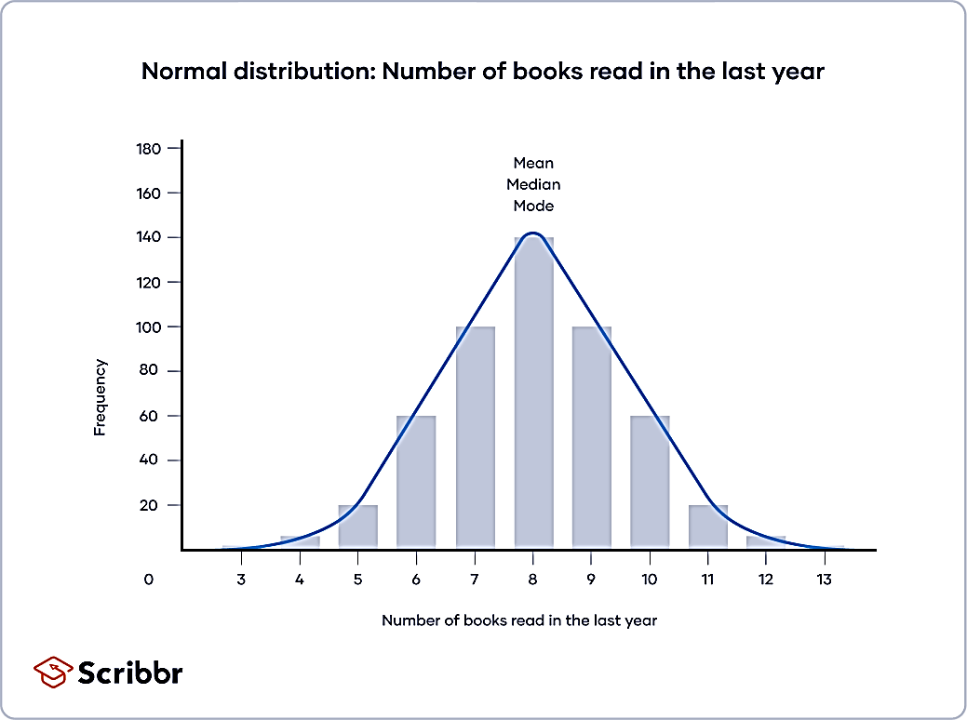
Normal distribution
In a normal distribution, data is symmetrically distributed with no skew. Most values cluster around a central region, with values tapering off as they go further away from the center. The mean, mode and median are exactly the same in a normal distribution.
Example: Normal distribution
You survey a sample in your local community on the number of books they read in the last year.
A histogram of your data shows the frequency of responses for each possible number of books. From looking at the chart, you see that there is a normal distribution.
The mean, median and mode are all equal; the central tendency of this dataset is 8.

Slide 9
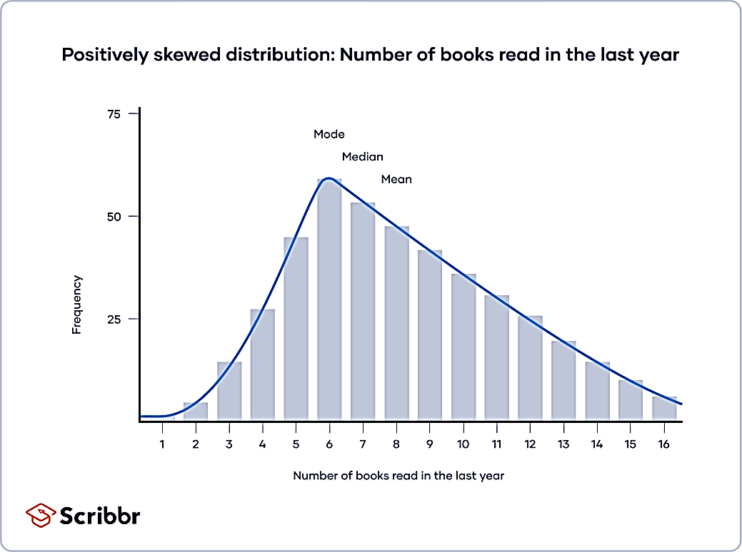
Skewed distributions
In skewed distributions, more values fall on one side of the center than the other, and the mean, median and mode all differ from each other. One side has a more spread out and longer tail with fewer scores at one end than the other. The direction of this tail tells you the side of the skew. In a positively skewed distribution, there’s a cluster of lower scores and a spread out tail on the right. In a negatively skewed distribution, there’s a cluster of higher scores and a spread out tail on the left.
In this histogram, your distribution is skewed to the right, and the central tendency of your dataset is on the lower end of possible scores.
In a positively skewed distribution,
mode < median < mean.

Slide 10
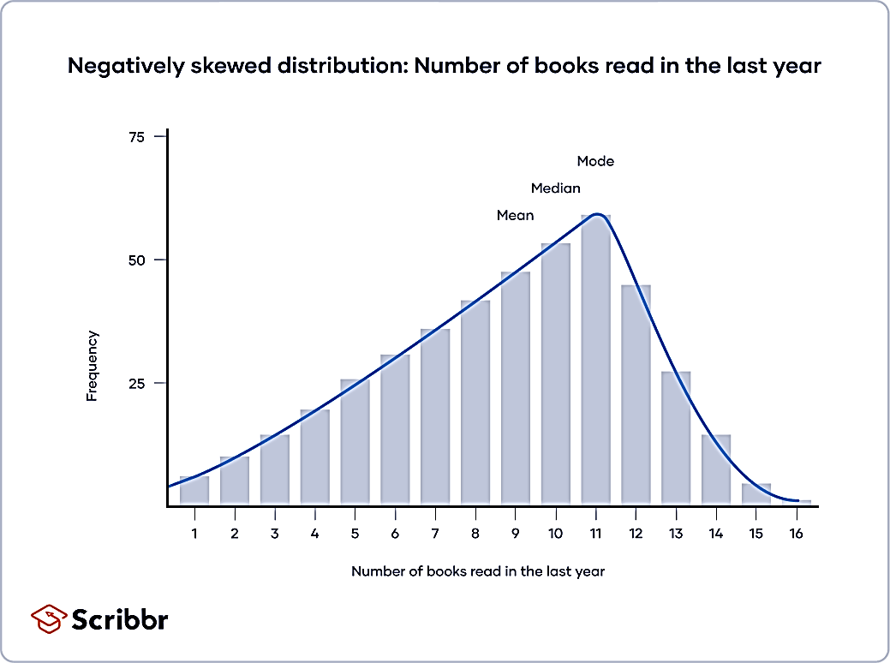
In this histogram, your distribution is skewed to the left, and the central tendency of your dataset is towards the higher end of possible scores.
In a negatively skewed distribution, mean < median < mode

Slide 11
Measures of Central Tendency Meaning
The representative value of a data set, generally the central value or the most occurring value that gives a general idea of the whole data set is called the Measure of Central Tendency.
Measures of central tendency helps to find the middle, or the average, of a dataset. The 3 most common measures of central tendency are the mode, median, and mean.
Mean
Median
Mode

Slide 12
Mode
The mode is the most frequently occurring value in the dataset. It’s possible to have no mode, one mode, or more than one mode. To find the mode, sort your dataset numerically or categorically and select the response that occurs most frequently.
Example: Finding the mode
In a survey, you ask 9 participants whether they identify as conservative, moderate, or liberal.
To find the mode, sort your data by category and find which response was chosen most frequently. To make it easier, you can create a frequency table to count up the values for each category.
Political ideology | Frequency
Conservative | 2
Moderate | 3
Liberal | 4
Mode=Liberal

Slide 13
When to use the mode
The mode is most applicable to data from a nominal level of measurement. Nominal data is classified into mutually exclusive categories, so the mode tells you the most popular category.
For continuous variables or ratio levels of measurement, the mode may not be a helpful measure of central tendency. That’s because there are many more possible values than there are in a nominal or ordinal level of measurement. It’s unlikely for a value to repeat in a ratio level of measurement.

Slide 14
Median
The median of a dataset is the value that’s exactly in the middle when it is ordered from low to high.
Example: Finding the median
You measure the reaction times of 7 participants on a computer task and categorize them into 3 groups: slow, medium or fast.
To find the median, you first order all values from low to high. Then, you find the value in the middle of the ordered dataset—in this case, the value in the 4th position.
Participant | 1 | 2 | 3 | 4 | 5 | 6 | 7
Speed | Medium | Slow | Fast | Fast | Medium | Fast | Slow
Ordered dataset | Slow | Slow | Medium | Medium | Fast | Fast | Fast
Median: Medium

Slide 15
Median of an odd-numbered dataset
For an odd-numbered dataset, find the value that lies at the (n+1)/2 position, where n is the number of values in the dataset.
Example
You measure the reaction times in milliseconds of 5 participants and order the dataset.
Reaction time (milliseconds) 287 298 345 365 380
The middle position is calculated using (n+1)/2, where n = 5.
=(5+1)/2 =3
That means the median is the 3rd value in your ordered dataset.

Slide 16
Median of an even-numbered dataset
For an even-numbered dataset, find the two values in the middle of the dataset: the values at the n/2 and (n/2)+1 positions. Then, find their mean.
Example
You measure the reaction times of 6 participants and order the dataset.
Reaction time (milliseconds) 287 298 345 357 365 380
The middle positions are calculated using n/2 and (n/2)+1, where n = 6.
( 6/2)=3
(6/2)+1=4
That means the middle values are the 3rd value, which is 345, and the 4th value, which is 357.
To get the median, take the mean of the 2 middle values by adding them together and dividing by 2.
(345+357)/2=351

Slide 17
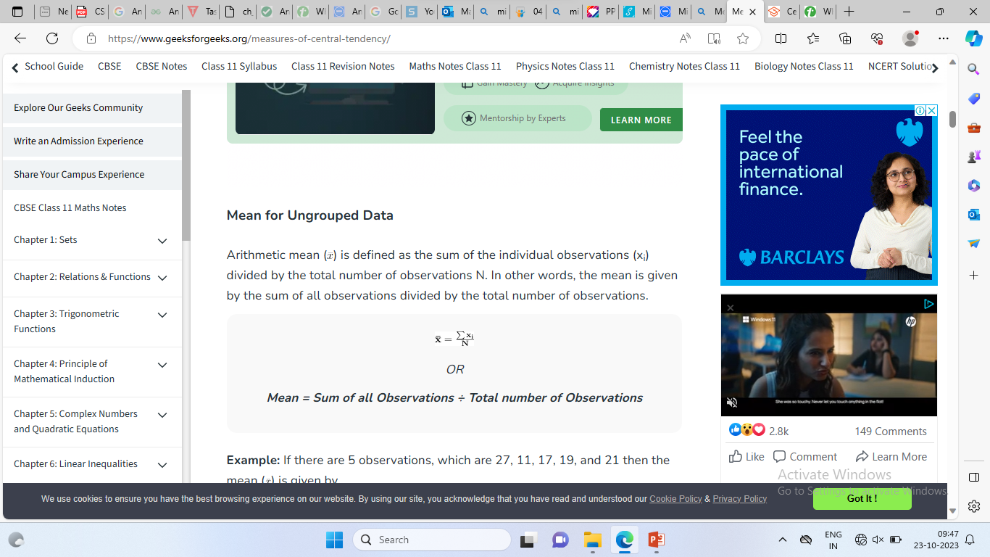
Mean
Mean in general terms is used for the arithmetic mean of the data, but other than the arithmetic mean there are geometric mean and harmonic mean as well that are calculated using different formulas.
Mean for Ungrouped Data
Arithmetic mean {x} is defined as the sum of the individual observations (xi) divided by the total number of observations N. In other words, the mean is given by the sum of all observations divided by the total number of observations.

Slide 18
Example: If there are 5 observations, which are 27, 11, 17, 19, and 21 then the mean is given by
mean = (27 + 11 + 17 + 19 + 21) ÷ 5
⇒ = 95 ÷ 5
⇒ mean = 19

Slide 19
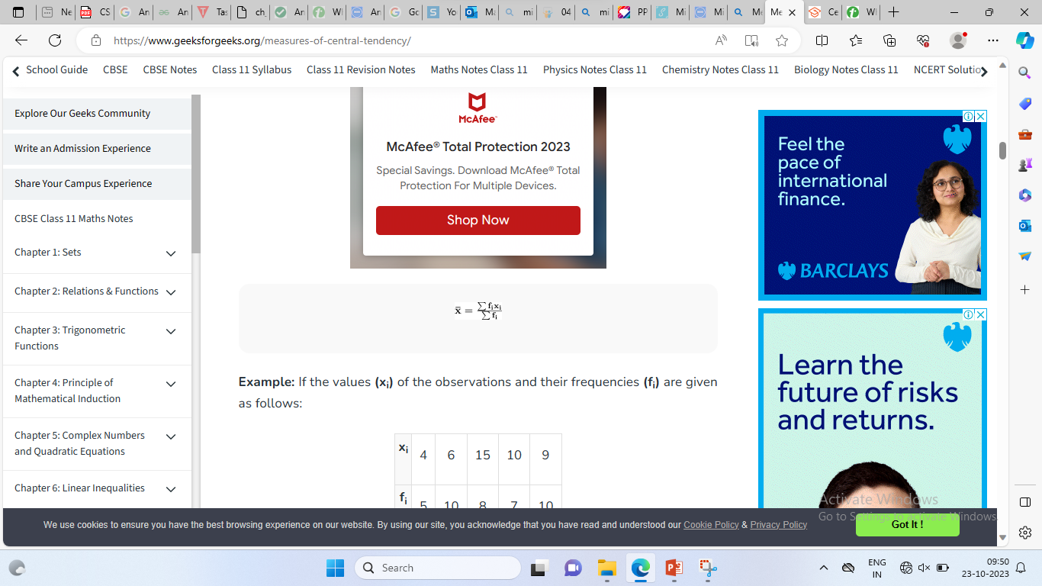
Mean for Grouped Data
Mean is defined for the grouped data as the sum of the product of observations (xi) and their corresponding frequencies (fi) divided by the sum of all the frequencies (fi).
Example: If the values (x_{i}) of the observations and their frequencies (f_{i}) are given as follows:
x_{i} | 4 | 6 | 15 | 10 | 9
f_{i} | 5 | 10 | 8 | 7 | 10

Slide 20
= (4×5 + 6×10 + 15×8 + 10×7 + 9×10) ÷ (5 + 10 + 8 + 7 + 10)
⇒ = (20 + 60 + 120 + 70 + 90) ÷ 40
⇒ = 360 ÷ 40
⇒ = 9

Slide 21
Measure of Dispersion

Slide 22
Definition
Measures of dispersion are descriptive statistics that describe how similar a set of scores are to each other
The more similar the scores are to each other, the lower the measure of dispersion will be
The less similar the scores are to each other, the higher the measure of dispersion will be
In general, the more spread out a distribution is, the larger the measure of dispersion will be

Slide 23
Measures of Dispersion
Which of the distributions of scores has the larger dispersion?
The upper distribution has more dispersion because the scores are more spread out
That is, they are less similar to each other

Slide 24
Measure of Dispersion is the numbers that are used to represent the scattering of the data. These are the numbers that show the various aspects of the data spread across various parameters. There are various measures of dispersion that are used to represent the data that includes,
Standard Deviation
Mean Deviation
Quartile Deviation
Variance
Range, etc
Dispersion in the general sense is the state of scattering. Suppose we have to study the data for thousands of variables there we have to find various parameters that represent the crux of the given data set. These parameters are called the measure of dispersion.

Slide 25
Example of Measures of Dispersion
We can understand the measure of dispersion by studying the following example, suppose we have 10 students in a class and the marks scored by them in a Mathematics test are 12, 14, 18, 9, 11, 7, 9, 16, 19, and 20 out of 20. Then the average value scored by the student in the class is,
Mean (Average) = (12 + 14 + 18 + 9 + 11 + 7 + 9 + 16 + 19 + 20)/10
= 135/10 = 13.5
Then, the average value of the marks is 13.5
Mean Deviation = {|12-13.5| + |14-13.5| + |18-13.5| + |9-13.5| + |11-13.5| + |7-13.5| + |9-13.5| + |16-13.5| + |19-13.5| + |20-13.5|}/10 = 34.5/10 = 3.45

Slide 26
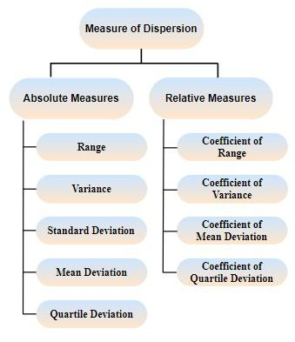
Types of Measures of Dispersion
Measures of dispersion can be classified into two categories shown below:
Absolute Measures of Dispersion
Relative Measures of Dispersion

Slide 27
Absolute Measures of Dispersion
These measures of dispersion are measured and expressed in the units of data themselves. For example – Meters, Dollars, Kg, etc. Some absolute measures of dispersion are:
Range
Mean Deviation
Standard Deviation
Variance
Quartile Deviation
Interquartile Range

Slide 28
The Range
The range is defined as the difference between the largest score in the set of data and the smallest score in the set of data, X_{L} - X_{S}
What is the range of the following data: 4 8 1 6 6 2 9 3 6 9
The largest score (X_{L}) is 9; the smallest score (X_{S}) is 1; the range is
X_{L} - X_{S} = 9 - 1 = 8

Slide 29
Range for Grouped Data
The range of the data set for the grouped data set is found by studying the following example,
Example: Find out the range for the following frequency distribution table for the marks scored by class 10 students.
Marks Intervals | Number of Students
0-10 | 5
10-20 | 8
20-30 | 15
30-40 | 9
For Largest Value: Taking the higher limit of Highest Class = 40
For Smallest Value: Taking the lower limit of Lowest Class = 0
Range = 40 – 0
Thus, the range of the given data set is,
Range = 40

Slide 30
When To Use the Range
The range is used when
you have ordinal data or
you are presenting your results to people with little or no knowledge of statistics
The range is rarely used in scientific work as it is fairly insensitive
It depends on only two scores in the set of data, X_{L} and X_{S}
Two very different sets of data can have the same range: 1 1 1 1 9 vs 1 3 5 7 9

Slide 31

Sample standard deviation
When you collect data from a sample, the sample standard deviation is used to make estimates or inferences about the population standard deviation.
The sample standard deviation formula looks like this:
 | = sample standard deviation = sum of… = each value = sample mean = number of values in the sample

Slide 32
Examples: A garden contains 39 plants. The following plants were chosen at random, and their heights were recorded in cm: 38, 51, 46, 79, and 57. Calculate their heights’ standard deviation.
Solution:
Given that, Number of observations = 5
Hence, the mean of 5 observations is:
Mean = (38 + 51 + 46 + 79 + 57)/5 = 54.2
Now, the standard deviation is calculated as follows:
Standard Deviation, SD = √[(Σ(xi – x̄)²) / (N-1)]
Now, substitute the values in the formula, we get
On solving the above expression, we get
S.D = 15.5

Slide 33

Mean Deviation
Range as a measure of dispersion only depends on the highest and the lowest values in the data. Mean deviation on the other hand measures the deviation of the observations from the mean of the distribution. Since the average is the central value of the data, some deviations might be positive and some might be negative. If they are added like that, their sum will not reveal much as they tend to cancel each other’s effect. For example,
Consider the data given below, -5, 10, 25
Mean = (-5 + 10 + 25)/3 = 10
Now a deviation from the mean for different values is,
(-5 -10) = -15
(10 – 10) = 0
(25 – 10) = 15

Slide 34

Standard Deviation
The standard deviation is the average amount of variability in your dataset. It tells you, on average, how far each value lies from the mean. In normal distributions, data is symmetrically distributed with no skew. Most values cluster around a central region, with values tapering off as they go further away from the center. The standard deviation tells you how spread out from the center of the distribution your data is on average.
Population standard deviation
When you have collected data from every member of the population that you’re interested in, you can get an exact value for population standard deviation.
The population standard deviation formula looks like this:
 | = population standard deviation = sum of… = each value = population mean = number of values in the population

Slide 35
Variance
Variance is defined as the average of the square deviations:

Slide 36
What Does the Variance Formula Mean?
First, it says to subtract the mean from each of the scores
This difference is called a deviate or a deviation score
The deviate tells us how far a given score is from the typical, or average, score
Thus, the deviate is a measure of dispersion for a given score

Slide 37
What Does the Variance Formula Mean?
Why can’t we simply take the average of the deviates? That is, why isn’t variance defined as:
This is not the formula for variance!

Slide 38
What Does the Variance Formula Mean?
One of the definitions of the mean was that it always made the sum of the scores minus the mean equal to 0
Thus, the average of the deviates must be 0 since the sum of the deviates must equal 0
To avoid this problem, statisticians square the deviate score prior to averaging them
Squaring the deviate score makes all the squared scores positive

Slide 39
What Does the Variance Formula Mean?
Variance is the mean of the squared deviation scores
The larger the variance is, the more the scores deviate, on average, away from the mean
The smaller the variance is, the less the scores deviate, on average, from the mean

Slide 40
Standard Deviation
Standard deviation = √variance
Variance = standard deviation²

Slide 41
Quartile Deviation & interquartile
Quartile deviation is a statistic that measures the deviation. It measures the deviation of the data from the average value. Here quartile deviation gives the spread of the data, which helps to understand the distribution of the data.
we have three quartiles Q₁, Q₂, Q₃ which divide the data into three quarters. The median of the data has been referred as the second quartile Q₂. Also, the first quartile Q₁ is the median of the first half of the data, and the third quartile Q₃ is the median of the second half of the data.
Quartile deviation is the dispersion in the middle of the data. The difference between the first quartile Q₁ and the third quartile Q₃ is called the interquartile range, and half of this interquartile range is called the quartile deviation. This quartile deviation is also referred to as a semi-interquartile range.

Slide 42
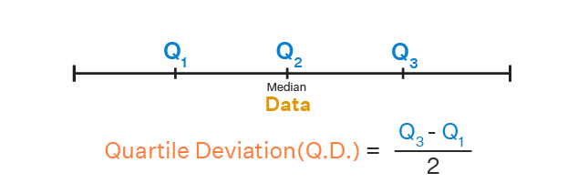
Example 1: Find the quartile deviation for the following given data.
23, 8, 5, 16, 33, 7, 24, 5, 30, 33, 37, 30, 9, 11, 26, 32
Let us arrange this data in the following ascending order.
5, 5, 7, 8, 9, 11, 16, 23, 24, 26, 30, 30, 32, 33, 33, 37
From the above data we have Q₁ = ( 8 + 9)/2 = 17/2 = 8.5, and Q₃ = (30 + 32)/2 = 62/2 = 31
Quartile Deviation = (Q3−Q1)/2=(31−8.52)/2
=22.52/2
=11.25

Slide 43
Relative Measures of Dispersion
Suppose we have to measure the two quantities that have different units than we used relative measures of dispersion to get a better idea about the scatter of the data. Various relative measures of the dispersion are:
Coefficient of Range: The coefficient of range is defined as the ratio of the difference between the highest and lowest value in a data set to the sum of the highest and lowest value.
Coefficient of Variation: The coefficient of Variation is defined as the ratio of the standard deviation to the mean of the data set. We use percentages to express the coefficient of variation.
Coefficient of Mean Deviation: The coefficient of the Mean Deviation is defined as the ratio of the mean deviation to the value of the central point of the data set.
Coefficient of Quartile Deviation: The coefficient of the Quartile Deviation is defined as the ratio of the difference between the third quartile and the first quartile to the sum of the third and first quartiles.

